Slide 1
Object-oriented Programming
Week 3 | Lecture 1,2 and 3

Slide 2
Constructor
A constructor is called whenever an object of a class is created
A constructor is a member function of a class which initializes objects of a class. In C++, Constructor is automatically called when object(instance of class) create.

Slide 3
How constructors are different from a normal member function?
Constructor has same name as the class itself
Constructors don’t have return type
A constructor is automatically called when an object is created.
If we do not specify a constructor, C++ compiler generates a default constructor for us (expects no parameters and has an empty body).

Slide 4
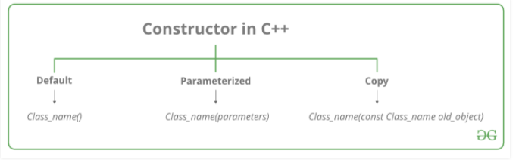
Types of constructors

Slide 5
Default Constructor
Default constructor is the constructor which doesn’t take any argument. It has no parameters.
Even if we do not define any constructor explicitly, the compiler will automatically provide a default constructor implicitly.

Slide 6
Default Constructor
class MyClass
{ public: //constructors are usually public
MyClass() { //Things you want to do as soon as object is created }
}

Slide 7
Constructor
C++ requires a constructor call for each object that is created
A constructor *looks* similar to a function except that it does not return anything (thus it does not have a return type)

Slide 8
Constructor
A constructor is used to initialize the data members/class variables for an object when that object is created
If you don’t define a constructor in a class, the compiler itself provides a default (no-parameter) constructor for that class

Slide 9
Example code
#include <iostream>
using namespace std;
class Line {
public:
void setLength( double len );
double getLength( void );
Line(); // This is the constructor
private:
double length;
};

Slide 10
Member functions definitions including constructor
Line::Line(void) {
cout << "Object is being created" << endl;
}
void Line::setLength( double len ) {
length = len;
}
double Line::getLength( void ) {
return length;
}

Slide 11
Main function for the program
int main() {
Line line;
// set line length
line.setLength(6.0);
cout << "Length of line : " << line.getLength() <<endl;
return 0;
}

Slide 12
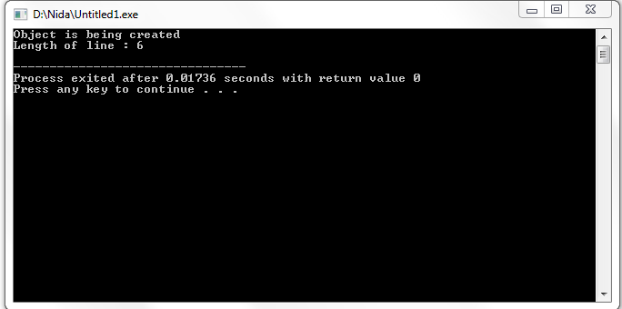
it produces the following result

Slide 13
Parameterized Constructors:
A constructor can take parameters. These parameters are used to initialize class variables for the object
class Employee
{
string name;
public: Employee(string eName) {
name = eName; }
}
int main() {
Employee e1(“Ali”); Employee e2(“Shuja”); }

Slide 14
Constructor
Can we have more than one parameterized constructors of a class?
Yes, we can. But not having the same parameter signature
If you define any parameterized constructor(s) in the class, C++ will not implicitly create a default constructor for you

Slide 15
Some Code
class A
{ int var; string str;
public: A(int v) {
var = v;
cout << "Constructor v1: " << var << endl;
}
A() {
var = 0;
cout << "Default constructor: " << var << endl;
}
A(string s)
{
str = s;
cout << "Constructor v2: " << str << endl;
}
};
int main() {
A dOb;
A iOb(50);
A sOb("Hello");
}

Slide 16
Some Code
class A
{ int var; string str;
public: A(int v) {
var = v;
cout << "Constructor v1: " << var << endl;
}
A(string s)
{
str = s;
cout << "Constructor v2: " << str << endl;
}
};
int main() {
A dOb; \\This line will give an error
A iOb(50);
A sOb("Hello");
}

Slide 17
Default Arguments in C++
A default argument is a value provided in a function declaration that is automatically assigned by the compiler if the caller of the function doesn’t provide a value for the argument with a default value.
Default arguments are overwritten when calling function provides values for them.

Slide 18
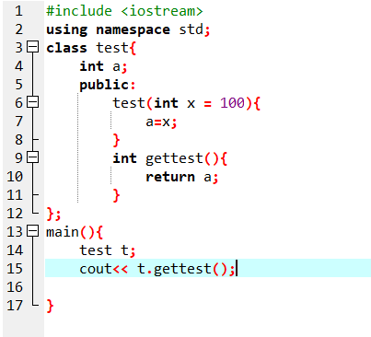

Slide 19
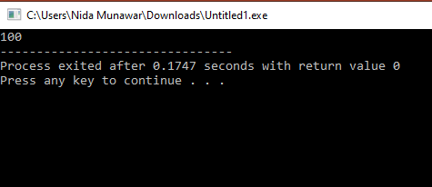

Slide 20
output of the following C++ code?
#include <iostream>
#include <string>
using namespace std;
class A{
int a;
public:
A(int i){
a = i;
}
void assign(int i){
a = i;
}
int return_value(){
return a;
}
};
int main()
{
A obj;
obj.assign(5);
cout<<obj.return_value();
}

Slide 21
Output
Error

Slide 22
output of the following C++ code?
#include <iostream>
#include <string>
using namespace std;
class A{
int a;
public:
A(int i= 100){
a = i;
}
void assign(int i){
a = i;
}
int return_value(){
return a;
}
};
int main()
{
A obj;
obj.assign(5);
cout<<obj.return_value();
}

Slide 23
output of the following C++ code?
#include <iostream>
#include <string>
using namespace std;
class A{
int a;
public:
A(int i= 100){
a = i;
}
A(){
}
void assign(int i){
a = i;
}
int return_value(){
return a;
}
};
int main()
{
A obj;
obj.assign(5);
cout<<obj.return_value();
}

Slide 24
Output
[Error] call of overloaded 'A()' is ambiguous

Slide 25

Rules for Default Arguments
1. Default values must be assigned from right to left.
• Wrong:
void test(int a = 5, int b); // ERROR: 'b' must have a default if 'a' has one
• Correct:
void test(int a, int b = 10);
2. Default arguments can only be specified once (either in function declaration or definition).
• Correct:
void show(int x = 100); // Default argument in declaration
void show(int x) { // Definition without default value std::cout << x; }
• Wrong:
void show(int x = 100); void show(int x = 200); // ERROR: Default argument redefined
3. Default arguments can be mixed with non-default ones, but non-default parameters must come first.
• Correct:
void print(int a, int b = 20, int c = 30);
• Wrong:
void print(int a = 10, int b, int c = 30); // ERROR

Slide 26
Anonymous classes in C++
Anonymous class is a class which has no name given to it
Anonymous classes cannot have explicit constructors or destructors, the compiler provides a default constructor.
These classes can neither be passed as arguments to functions nor can be used as return values from functions.

Slide 27
Anonymous classes in C++
#include <iostream>
using namespace std;
class
{
int i;
public:
void setData(int a) {
i = a;
}
void print(){
cout << "Value for i : " << this->i << endl;
}
} obj1, obj2; // multiple objects for anonymous class
// Driver function
int main() {
obj1.setData(10);
obj1.print();
obj2.setData(20);
obj2.print();
return 0;
}

Slide 28
this POINTER
Each object gets its own copy of the data member.
All-access the same function definition as present in the code segment.
Meaning each object gets its own copy of data members and all objects share a single copy of member functions. Then now question is that if only one copy of each member function exists and is used by multiple objects, how are the proper data members are accessed and updated?

Slide 29
this POINTER
#include <iostream>
using namespace std;
class car{
int a;
public:
car(int e){
a=e;}
void set(int e){
a=e; //you always see the data member which belong to particular object it never mixed up
}};
int main(){
car c(10);
car c1(12);
c.set(22); // when you call some member function using some object
c1.set(32);
}

Slide 30
this POINTER
You can access class members using By default, the compiler provides each member function of a class with an implicit parameter that points to the object through which the member function is called. The implicit parameter is this pointer.

Slide 31
This pointer holds the address of current/ calling object
#include <iostream>
using namespace std;
class car{
int a;
public:
car(int e){
a=e;}
void set(int e){
this -> a=e; // this is how compiler internally achieve this
}};
int main(){
car c(10);
car c1(12);
c.set(22); // when you call some member function using some object
c1.set(32);
}

Slide 32
Note
When you call a non-static member function on an object, the compiler implicitly passes the address of the calling object (this) to the function.

Slide 33
For example, the following two calls are equivalent:
obj.show(); // Implicitly: show(&obj)
obj.setValue(5); // Implicitly: setValue(&obj, 5)
Internally, the compiler transforms:
class Example {
public:
void show() {
std::cout << "Hello" << std::endl; } };
Into something like this:
class Example {
public:
void show(Example* this) {
// Compiler implicitly passes 'this’
std::cout << "Hello" << std::endl; } };

Slide 34
Does the Compiler Pass this to Constructors?
Yes, the compiler always passes this to non-static member functions, including constructors.
You don’t need to write this explicitly unless there is a name conflict (e.g., between constructor parameters and member variables).
this is not required in static functions because they don’t belong to any specific instance.

Slide 35
1. usage of this pointer Print address of object inside class
#include <iostream>
using namespace std;
class car{
int a;
public:
void set(int e){
a=e; }
void printAddress(){
cout << this << endl;
}};
int main(){
car obj1;
car obj2;
obj1.printAddress(); // address of obj1
obj2.printAddress();// address of obj2
}

Slide 36
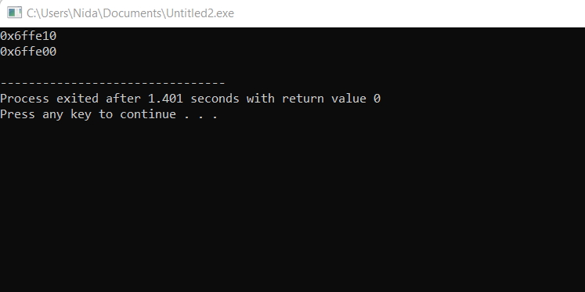
Print address of object inside class

Slide 37
Print address of object inside and outside the class
#include <iostream>
using namespace std;
class car{
int a;
public:
void set(int e){
a=e; }
void printAddress(){
cout << this << endl;
}};
int main(){
car obj1;
car obj2;
obj1.printAddress(); // address of obj1
obj2.printAddress();// address of obj2
cout << &obj1 << endl;// address of obj1
cout << &obj2;// address of obj2
}

Slide 38
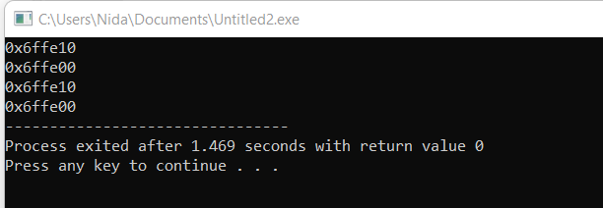
Print address of object inside and outside the class

Slide 39
2. usage of this pointer When local variable’s name is same as member’s name
#include <iostream>
using namespace std;
class example{
private:
int x; public:
void set(int x){
x = x;}
void printAddressAndValue(){
cout<< "the value is "<<x<<endl;}};
main(){
example e;
e.set(3);
e.printAddressAndValue();}

Slide 40
When local variable’s name is same as member’s name
#include <iostream>
using namespace std;
class example{
private:
int x; public:
void set(int x){
(*this).x = x;} // The 'this' pointer is used to retrieve the object's x
// hidden by the local variable 'x'
void printAddressAndValue({
cout<<"The address is "<<this<<" and the value is "<<(*this).x<<endl;}};
main(){
example e;
e.set(3);
e.printAddressAndValue();}

Slide 41
this POINTER
#include <iostream>
using namespace std;
class example{
private:
int x; public:
void set(int x){
this->x = x;}
void printAddressAndValue(){
cout<<"The address is "<<this<<" and the value is "<<this->x <<endl;
}
};
main(){
example e;
e.set(3);
e.printAddressAndValue();}

Slide 42
Next Lecture
Destructors!

Slide 43

“Prepare to Die”

Slide 44
Destructor
A class’s destructor is automatically called when an object of that class is “destroyed”
Destruction of an object means when program execution leaves the scope in which object was instantiated
Destructors are a “prepare to die” member function. They are often abbreviated “dtor”.

Slide 45
Destructor
We can declare a destructor by adding a tilde (~) as prefix to its class name.
Has the same name as that of class Example: ~MyClass() { . . . }

Slide 46
Destructor
A destructor cannot return a value and cannot take any arguments
A destructor cannot be overloaded
A class can thus have only one destructor
If you do not explicitly define a destructor, the compiler provides a default “empty” destructor

Slide 47
Order of calling Destructors
class MyClass
{ int objectID; MyClass(int objectID1) { objectID = objectID1; } ~MyClass() { cout << objectID << “ deleted”; }
}

Slide 48
#include <iostream>
using namespace std;
class ABC{
public:
ABC () //constructor defined
{
cout << "Hey look I am in constructor" << endl; }
~ABC() //destructor defined
{
cout << "Hey look I am in destructor" << endl;}};
int main(){
ABC cc1; //constructor is called
ABC cc2; //constructor is called
cout << "function main is terminating...." << endl;
return 0;
}

Slide 49
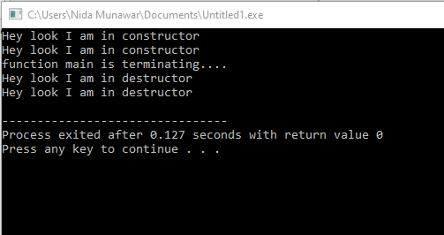

Slide 50
Order of calling Destructors
Destructors for nonstatic member objects are called in the reverse order in which they appear in the class declaration
When objects store in the stack order will be LIFO

Slide 51
Order of calling Destructors
MyClass ob1 (1);
void func()
{
MyClass ob3 (3); MyClass ob4 (4);
}
int main()
{
MyClass ob2 (2); func(); MyClass ob5 (5);
}

Slide 52
Order of calling Destructors
MyClass ob1 (1); \\ destroyed fifth
void func()
{
MyClass ob3 (3); \\ destroyed second MyClass ob4 (4); \\ destroyed first
}
int main()
{
MyClass ob2 (2); \\ destroyed fourth func(); MyClass ob5 (5); \\ destroyed third
}

Slide 53
What’s the order that local objects are destructed?
In reverse order of construction: First constructed, last destructed.(LIFO)
In the following example, b’s destructor will be executed first, then a’s destructor:
void userCode()
{
Fred a;
Fred b;
// ...
}

Slide 54
What’s the order that the objects in an array are destructed?
In reverse order of construction: First constructed, last destructed.
In the following example, the order for destructors will be a[9], a[8], …, a[1], a[0]:
void userCode()
{
Fred a[10];
// ...
}

Slide 55
Why are Destructors useful?
Useful for garbage collection
Garbage-collected languages like JAVA do not have a destructor
There is no guarantee of when an object will be destroyed

Slide 56
When do we need to write a user-defined destructor?
If we do not write our own destructor in class, compiler creates a default destructor for us. The default destructor works fine unless we have dynamically allocated memory or pointer in class. When a class contains a pointer to memory allocated in class, we should write a destructor to release memory before the class instance is destroyed. This must be done to avoid memory leak.

Slide 57
When do we need to write a user-defined destructor?
only variables allocated on the stack are deallocated automatically when they go out of scope.
We need to call the destructor if have allocated memory in heap

Slide 58
#include <iostream>
using namespace std;
class Test{
public:
Test(){
cout << "Constructor" << endl;}
~Test(){
cout << "Destructor" << endl; }
void display(){
cout << "Display content" << endl;}
};
int main(){
Test a;
a.display();}

Slide 59
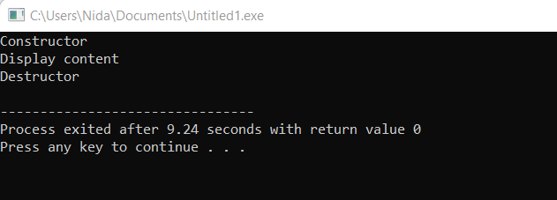
Here we do not want to call the destructor explicitly because we have created the object in the stack, not in heap. So, after object goes out of scope destructor will call automatically.

Slide 60
What if we create the object in heap instead of stack?
#include <iostream>
using namespace std;
class Test{
public:
Test(){
cout << "Constructor" << endl;}
~Test(){
cout << "Destructor" << endl;}
void display(){
cout << "Display content" << endl;}
};
int main(){
Test *a = new Test();
a->display();}

Slide 61
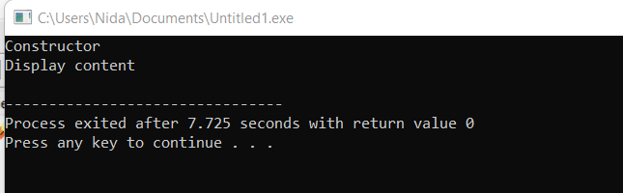
What if we create the object in heap instead of stack?
But in this scenario, you can see that it will not call the destructor automatically. So, we have to call it explicitly. Unless memory will not be released at the end of the scope of the object. We can call delete in order to invoke the destructor manually.

Slide 62
Why the Destructor is Not Called:
The destructor is called automatically when an object goes out of scope
(for stack-allocated objects) or when delete is explicitly called on a pointer to
a dynamically allocated object.
In this case, since delete is not called, the memory is not freed, and the
destructor is not executed. This results in a memory leak.

Slide 63
We can call delete in order to invoke the destructor manually.
#include <iostream>
using namespace std;
class Test{
int a;
public:
Test(){
a=10;
cout << "Constructor" << endl;}
~Test(){
cout << "Destructor" << endl;}
void display(){
cout << "Display content " << a << endl;}
};
int main(){
Test *a = new Test();
a->display();
delete a;
}

Slide 64
We can call delete in order to invoke the destructor manually.
#include <iostream>
using namespace std;
class Test{
int a;
public:
Test(){
a=10;
cout << "Constructor" << endl;}
~Test(){
cout << "Destructor" << endl;}
void display(){
cout << "Display content" << a << endl;}
};
int main(){
Test *a = new Test();
delete a;
a->display();
}

Slide 65
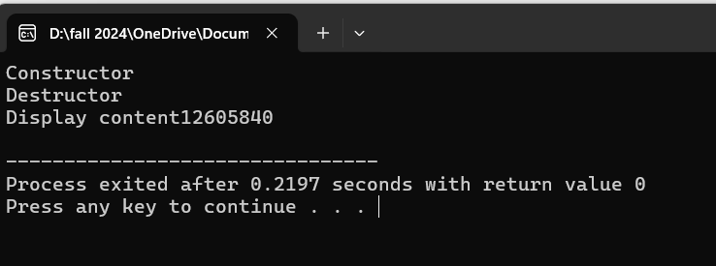

Slide 66
Another example When do we need to write a user-defined destructor?
#include <iostream>
using namespace std;
class ABC
{
int *p;
public:
ABC () //constructor defined
{
p=new int;
cout << "inside constructor" << endl;
}
~ABC() //destructor defined
{
delete p;
cout << "inside destructor" << endl;
}
};

Slide 67
When do we need to write a user-defined destructor?
int main()
{
ABC cc1; //constructor is called
ABC cc2; //constructor is called
cout << "function main is terminating...." << endl;
/*....object cc1 goes out of scope ,now destructor is being called...*/
return 0;
} //end of program

Slide 68
Output?
#include <iostream>
using namespace std;
class ABC{
int *p;
public:
ABC () {
p=new int;
cout << "inside constructor" << endl; }
~ABC() {
cout << "inside destructor" << endl;
}};
int main(){
ABC cc1;
ABC cc2;
cout << "function main is terminating...." << endl;
return 0;}

Slide 69
What is a memory leak?
if we continuously allocate memory(dynamicly) for a particular object without releasing that memory after completing its task, that memory can not be used in future. Because, although object has completed its task, it is holding that memory because we have not released it properly. So, others cannot grab that memory for their executions. This wasted memory can be started in few bytes but eventually, end up in megabytes or even more. This might slow down your application in execution when it finds hard to allocate memory or may be crashed as it failed to allocate enough memory for its execution. So, destructor comes in handy to deallocate memory that it has allocated when the constructor was called.

Slide 70
Exercise
Write a program to print the names of students by creating a Student class. If no name is passed while creating an object of the Student class, then the name should be "Unknown", otherwise the name should be equal to the String value passed while creating the object of the Student class.(use constructor and destructor)

Slide 71
References in C++
When a variable is declared as a reference, it becomes an alternative name for an existing variable. A variable can be declared as a reference by putting ‘&’ in the declaration.
data_type &ref = variable;

Slide 72
use of references
#include <iostream>
using namespace std;
int main()
{
int x = 10;
// ref is a reference to x.
int& ref = x;
// Value of x is now changed to 20
ref = 20;
cout << "x = " << x << '\n';
// Value of x is now changed to 30
x = 30;
cout << "ref = " << ref << '\n';
return 0;
}

Slide 73
Passing By Pointer vs Passing By Reference in C++

Slide 74
pass by pointer
#include <iostream>
using namespace std;
void swap(int *x, int *y)
{
int z = *x;
*x = *y;
*y = z;
}
// Driver Code
int main()
{
int a = 45, b = 35;
cout << "Before Swap\n";
cout << "a = " << a << " b = " << b << "\n";
swap(&a, &b);
cout << "After Swap with pass by pointer\n";
cout << "a = " << a << " b = " << b << "\n";
}

Slide 75
Passing By Reference
It allows a function to modify a variable without having to create a copy of it. We have to declare reference variables. The memory location of the passed variable and parameter is the same and therefore, any change to the parameter reflects in the variable as well.

Slide 76
Modify the passed parameters in a function:
#include <iostream>
using namespace std;
// Function having parameters as
// references
void swap(int& first, int& second)
{
int temp = first;
first = second;
second = temp;
}
int main()
{
int a = 2, b = 3;
swap(a, b);
// changes can be seen printing both variables
cout << a << " " << b;
return 0;
}

Slide 77
Next Lecture
Copy Constructor!

Slide 78
Copy Constructor
creating a copy of an object means to create an exact replica of the object having the same literal value, data type, and resources.

Slide 79
Syntax
Syntax 1:
Test Obj; Test Obj1(Obj); Syntax 2:
Test Obj; Test Obj1 = Obj;
Syntax 3: Test Obj;
Test Obj2; Obj2 = Obj;

Slide 80
Initializing one object with another
#include <iostream>
using namespace std;
class A{
int val;
public:
A(int val1) {
val = val1; }
void update() { val++; }
void showVal() { cout << "Value: " << val << endl; }
};
int main()
{
A a1( 10 );
a1.showVal( );
A a2 = a1;
a2.showVal();
a2.update();
a1.showVal( );
a2.showVal( );
}

Slide 81
Initializing one object with another
class A{
int val;
public:
A(int val1) {
val = val1; }
A(){ }
void setVal(int val1) { val = val1; }
void showVal() { cout << "Value: " << val << endl; }
};

Slide 82
Initializing one object with another
int main()
{
A a1( 10 );
a1.showVal( );
A a2 = a1;
a2.showVal( );
a2.setVal( 20 );
a1.showVal( );
a2.showVal( );
}

Slide 83
Initializing one object with another
int main()
{
A a1( 10 );
a1.showVal( );
A a2 = a1;
a2.showVal( );
a2.setVal( 20 );
a1.showVal( );
a2.showVal( );
}
OUTPUT:
Val: 10 a1.val
Val: 10 a2.val
Val: 10 a1.val
Val: 20 a2.val

Slide 84
Initializing one object with another
int main()
{
A a1( 10 );
a1.showVal( );
A a2;
a2 = a1;
a2.showVal( );
a2.setVal( 20 );
a1.showVal( );
a2.showVal( );
}
OUTPUT:
Val: 10 a1.val
Val: 10 a2.val
Val: 10 a1.val
Val: 20 a2.val

Slide 85
Initializing one object with another
int main()
{
A a1( 10 );
a1.showVal( );
A a2(a1);
a2.showVal( );
a2.setVal( 20 );
a1.showVal( );
a2.showVal( );
}
OUTPUT:
Val: 10 a1.val
Val: 10 a2.val
Val: 10 a1.val
Val: 20 a2.val

Slide 86
Copy Constructor
A copy constructor is used to initialize an object using another object of the same class
A copy constructor has the following prototype:
ClassName (const ClassName &ob);

Slide 87
Copy Constructor
If we don’t define our own copy constructor, the compiler creates a default copy constructor for each class
The default copy constructor performs member-wise copy between objects
Default copy constructor works fine unless an object has pointers or any runtime allocation

Slide 88
Shallow Copy
Default constructor always perform a shallow copy
In shallow copy, an object is created by simply copying the data of all variables of the original object.

Slide 89
With new keyword
#include <iostream>
using namespace std;
class A{
int val;
int *ptr;
public:
A(int val1,int p) {
val = val1;
ptr = new int;
*ptr = p;}
void update() { val++; (*ptr)++;}
void showVal() { cout << "Value: " << val <<" ptr is "
<<*ptr << endl; }
};
int main()
{
A a1( 10,20 );
a1.showVal( );
A a2 = a1;
a2.showVal();
a2.update();
a1.showVal( );
a2.showVal( );
}

Slide 90
Without new same problem
#include <iostream>
using namespace std;
class A {
int val;
int *ptr; // Points to an external variable
public:
A(int val1, int &p) {
val = val1;
ptr = &p;
}
void update() {
val++;
(*ptr)++;
}
void showVal() {
cout << "Value: " << val << ", ptr is " << *ptr << endl;
}
};
int main() {
int x = 20;
A a1(10, x);
a1.showVal();
A a2 = a1; // Both share the same x
a2.showVal();
a2.update();
a1.showVal();
a2.showVal();
cout << "x value: " << x << endl;
return 0;
}

Slide 91
Reference variable
#include <iostream>
using namespace std;
class A {
int val;
int &ref; // Reference to an external variable
public:
A(int val1, int &p) : val(val1), ref(p) {} // Initialize reference in initializer list
void update() {
val++;
ref++; // Directly modify the referenced variable
}
void showVal() {
cout << "Value: " << val << ", ref is " << ref << endl;
}
};
int main() {
int x = 20;
A a1(10, x); // `ref` in a1 now refers to x
a1.showVal();
A a2 = a1; // Both `a1` and `a2` refer to the same `x`
a2.showVal();
a2.update(); // Updates both val and `x`
a1.showVal();
a2.showVal();
cout << "x value: " << x << endl;
return 0;
}

Slide 92
Another example
#include <iostream>
using namespace std;
class box {
int length;
int breadth;
int height;
public:
void set_dimensions(int length1, int breadth1, int height1)
{
length = length1;
breadth = breadth1;
height = height1;
}

Slide 93
Another example
void show_data()
{
cout << " Length = " << length
<< "\n Breadth = " << breadth
<< "\n Height = " << height
<< endl;
}
};

Slide 94
Another example
// Driver Code
int main()
{
box B1, B3;
// Set dimensions of Box B1
B1.set_dimensions(14, 12, 16);
B1.show_data();
box B2 = B1;
B2.show_data();
B3 = B1;
B3.show_data();
return 0;
}

Slide 95
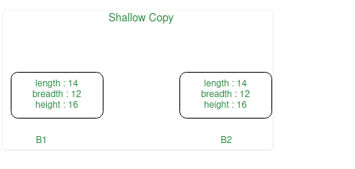

Slide 96
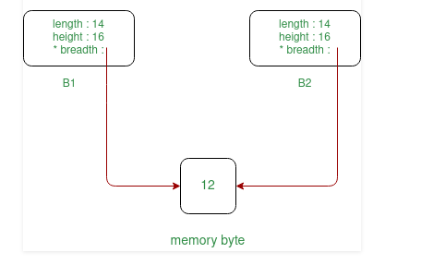
Shallow Copy of object if some variables are defined in heap memory, then:

Slide 97
Deep Copy
Deep copy is only possible with user-defined copy constructors
In user-defined copy constructors, we make sure that pointers (or references) of copied object point to new memory locations

Slide 98
Deep copy
#include <iostream>
using namespace std;
class A{
int val;
int *ptr;
public:
A(int val1,int p) {
val = val1;
ptr = new int;
*ptr = p;}
void update() { val++; (*ptr)++;}
void showVal() { cout << "Value: " << val <<" ptr is "
<<*ptr << endl;
}
A(const A &other) {
val = other.val;
ptr = new int;
*ptr= *(other.ptr);} // Allocate and copy the value
};
int main()
{
A a1( 10,20 );
a1.showVal( );
A a2(a1);
a2.showVal();
a2.update();
a1.showVal( );
a2.showVal( );
}

Slide 99
Deep Copy
#include <iostream>
using namespace std;
class A{
int val;
int *ptr;
public:
A(int val1,int p) {
val = val1;
ptr = new int;
*ptr = p;}
void update() { val++; (*ptr)++;}
void showVal() { cout << "Value: " << val <<" ptr is "
<<*ptr << endl;
}
A(const A &other) {
val = other.val;
ptr = new int(*(other.ptr)); } // Allocate and copy the value
};
int main()
{
A a1( 10,20 );
a1.showVal( );
A a2 = a1;
a2.showVal();
a2.update();
a1.showVal( );
a2.showVal( );
}

Slide 100
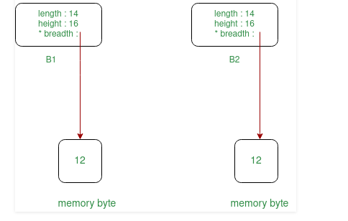
Deep Copy

Slide 101
Another example
#include <iostream>
using namespace std;
class box {
int length;
int* breadth;
int height;
public:
box() {
breadth = new int; }
void set_dimension(int len, int brea, int heig) {
length = len;
*breadth = brea;
height = heig; }
void show_data() {
cout << " Length = " << length
<< "\n Breadth = " << *breadth
<< "\n Height = " << height
<< endl; }

Slide 102
Another example
box(box& sample)
{
length = sample.length;
breadth = new int;
*breadth = *(sample.breadth);
height = sample.height;
}
// Destructors
~box()
{
delete breadth;
}
};

Slide 103
Another example
// Driver Code
int main()
{
// Object of class first
box first;
// Set the dimensions
first.set_dimension(12, 14, 16);
// Display the dimensions
first.show_data();
box second = first;
// Display the dimensions
second.show_data();
return 0;
}

Slide 104
Why copy constructor?
If we remove copy constructor from the above program, we don’t get the expected output
The changes made to second reflect in first as well which is never expected.

Slide 105
Discussion
Can we make copy constructor private?
Why argument to a copy constructor must be passed as a reference?
Why argument to a copy constructor should be const?

Slide 106
Can we make copy constructor private
Yes, you can make a copy constructor private member in C++. Making so, you are restricting someone copying your object during object creation.
objects of that class become non-copyable
A common reason to make copy constructor private is to disable default implementation of these operations.

Slide 107
Why argument to a copy constructor must be passed as a reference?
It is very essential to pass objects as reference. If an object is passed as value to the Copy Constructor then its copy constructor would call itself, to copy the actual parameter to the formal parameter. Thus an endless chain of call to the copy constructor will be initiated. This process would go on untill the system run out of memory.

Slide 108
class MyClass {
public:
MyClass(MyClass obj) { // Incorrect: passing by value
std::cout << "Copy constructor called" << std::endl;
}
};
int main() {
MyClass obj1; // This line will cause infinite recursion (if allowed)
MyClass obj2 = obj1; // Calls the copy constructor
}

Slide 109
Why argument to a copy constructor should be const?
we should use const in C++ wherever possible so that objects are not accidentally modified

